Slide 1
Foras Promineo Software Flowcharts

Slide 2
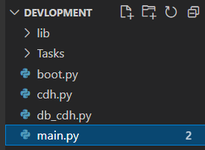
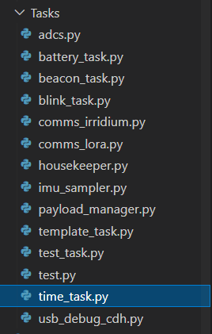
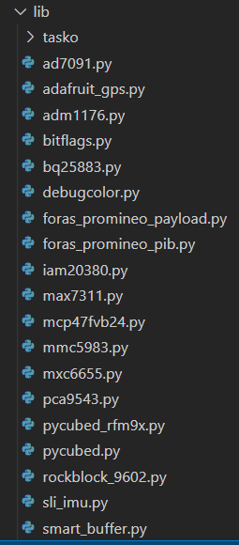
File Structure
Lib Directory:
All lib files for usage. Each lib follows a fairly similar format
Top Level:
cdh, boot, and main files
Task Directory:
Tasks

Slide 3

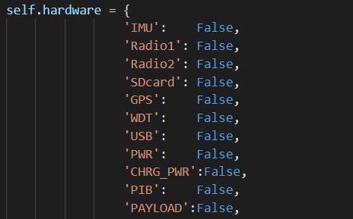
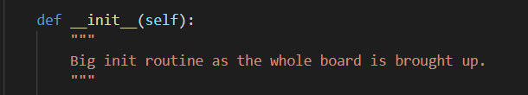
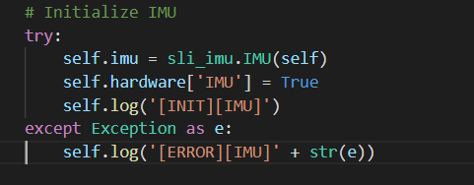
Master Library
Init routine initializes each device in self.hardware
Each initialization for the devices is within its own try – except clause.
Hardware dictionary for each device in this library
Example device init.

Slide 4
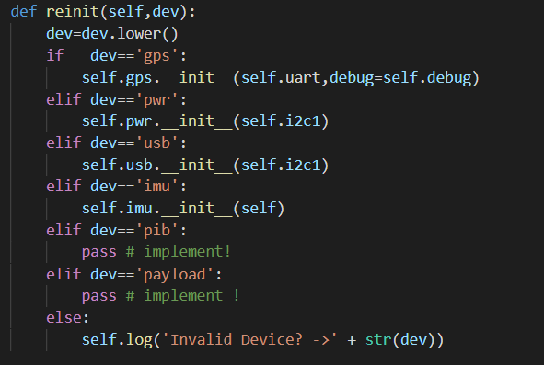
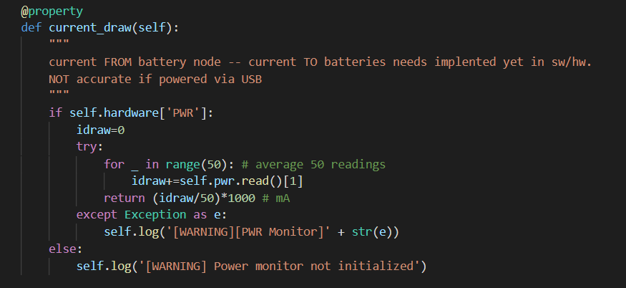
Master Library
Every board-level hardware lib has a reinit procedure !!!
Example of a property, i.e. class variable

Slide 5
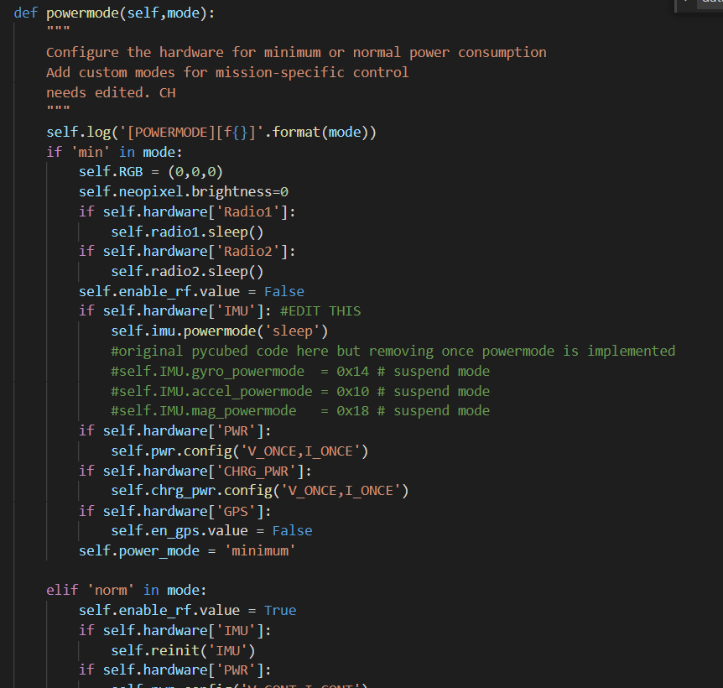
Master Library
Two power modes, min and norm.
Handling and initiating different power modes is to be implemented in housekeeper.py task

Slide 6

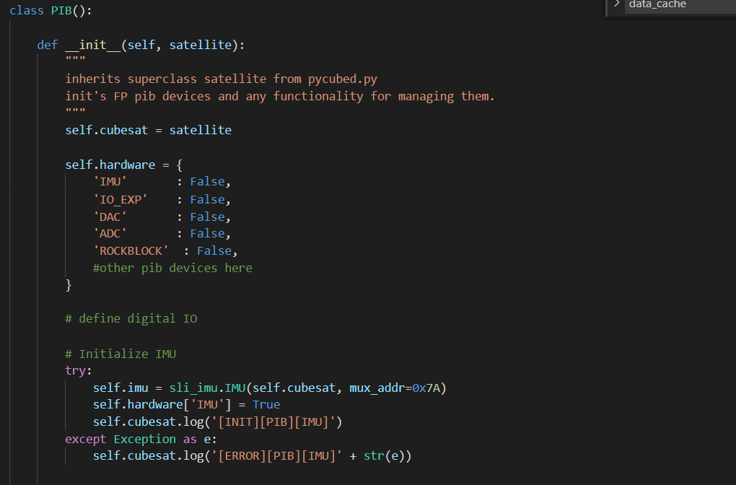
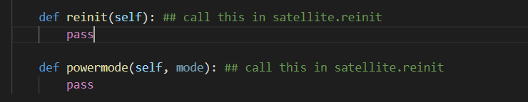
Sub library example

Slide 7
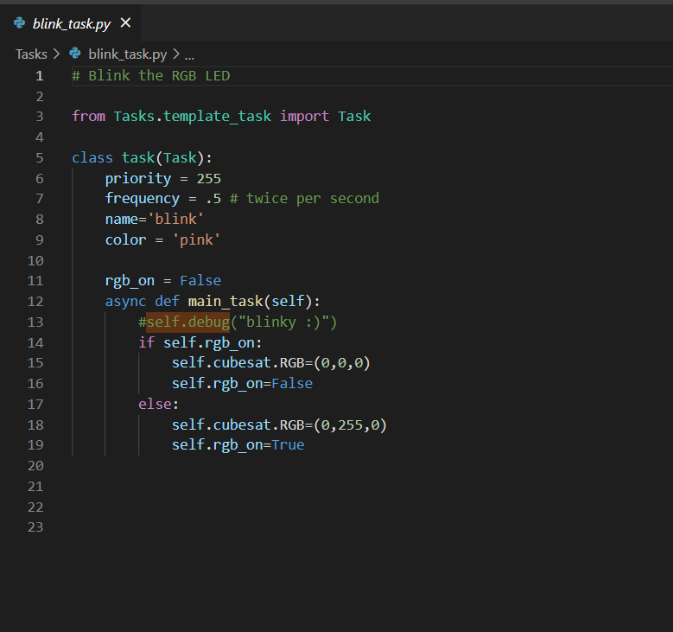
Anatomy of a Task
The mainboard executes tasks via a task scheduler
This is a task that blinks the led.
It is a subclass of task from template_task.py
When the task is executed, it runs the code within main_task.
Pycubed.py is self.cubesat
See priority and frequency for setting when a task will run

Slide 8
Current Progress (as of 6/1/21)
Mainboard is functional and all peripherals are coded in.
A new design revision will be made soon with some new features and some pinout changes.
Payload interface board libraries in progress
~50% complete
Tasks have been started, but nothing of substance there

Slide 9
Things to Do:
Define operating states and what tasks should run at what times
Code high-level functionality
i.e. all the tasks, commands, data handling
Define radio>mainboard>payload data exchange for target bitrate
Test it for extended periods
Code pc-side software to display live telemetry and other things

